Slide 1

How certain aspects of Olympics have changed over the years and affected medal counts
July 7th, 2021
Wildcats

Slide 2

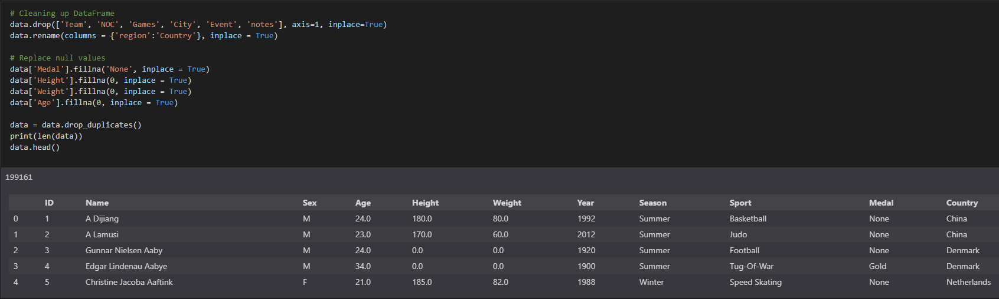
Introduction - Data Used and Cleaning
Notes:
With Tokyo Olympics coming up in a few month, we wanted to look for observable trends and visualize them from what we have learned so far in the course. The first Summer Olympic Games was in 1896; first Winter Games was in 1924.
Columns= [ID, Name, Sex, Age, Height, Weight, Team, NOC, Games, Year, Season, City, Sport, Event, Medal, region, notes]

Slide 3

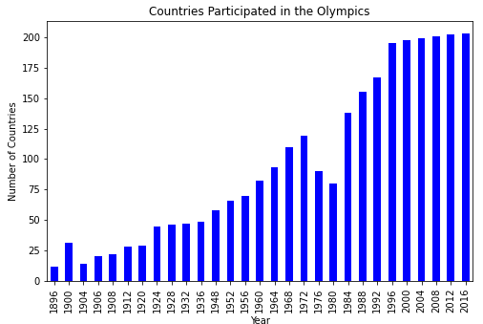
Countries participation over the years
Notes:
The first Olympic game in 1896 had only (10+) countries to participate while (200+) countries participated in the Olympic game. Significant decrease in the number of countries was seen in 1980 due to many countries boycotting the event.

Slide 4

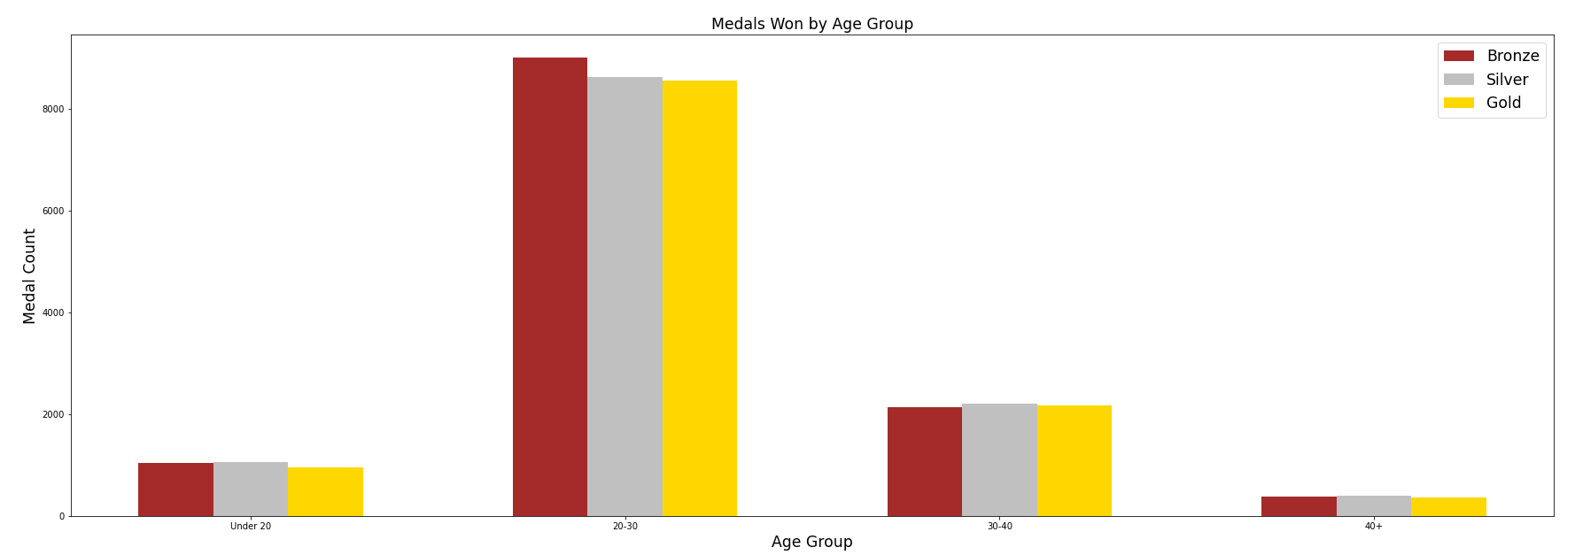
Medals Won by Age Group
.
Notes:
The best chance for someone to win any medal would be between the ages of 20-30

Slide 5

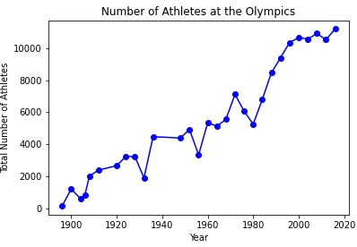
Number of athletes participation over the year
Notes:
Participation of athletes have naturally increased over the years contributed by significant growth in number of female athletes.

Slide 6
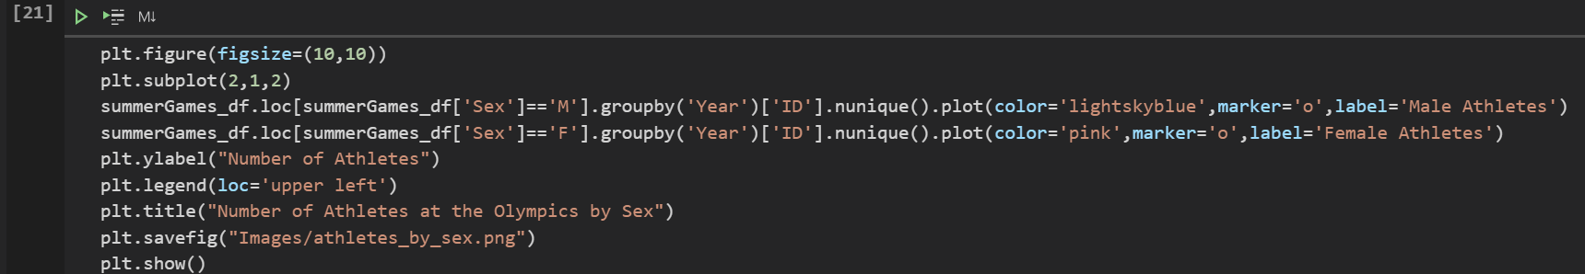
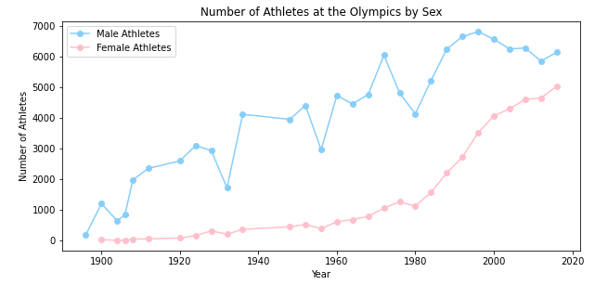
Number of athletes participation over the year
Notes:
Participation of athletes have naturally increased over the years contributed by significant growth in number of female athletes.

Slide 7
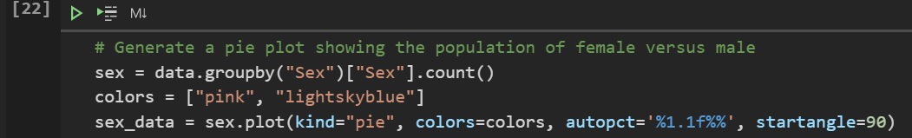
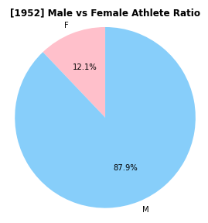
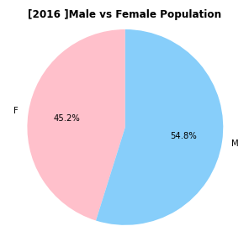


Male vs Female participation change over the years
Notes:
Number of female athletes have significantly increased over the years from what it was 12.1% of the total population in 1952 which grew to similar number to male at 45.2% in 2016 which indicates gender equality is gradually being achieved in Olympic games from a participants’ point of view.

Slide 8



Medals won by countries

Slide 9

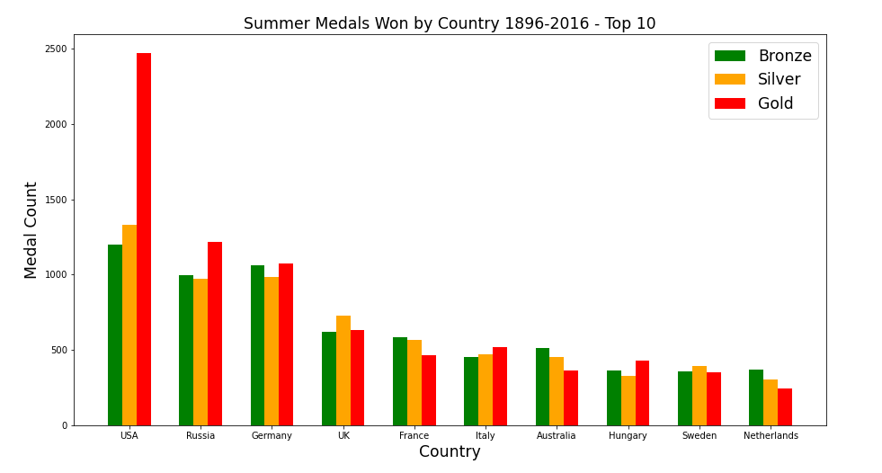
Medals won by countries

Slide 10
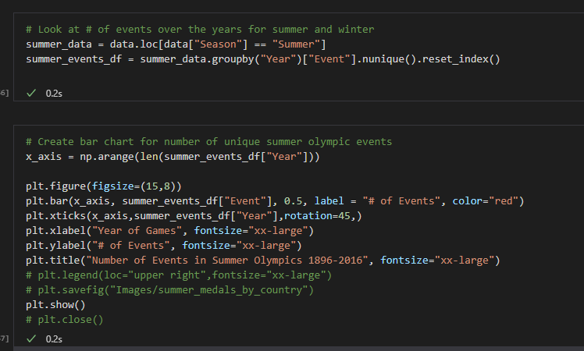
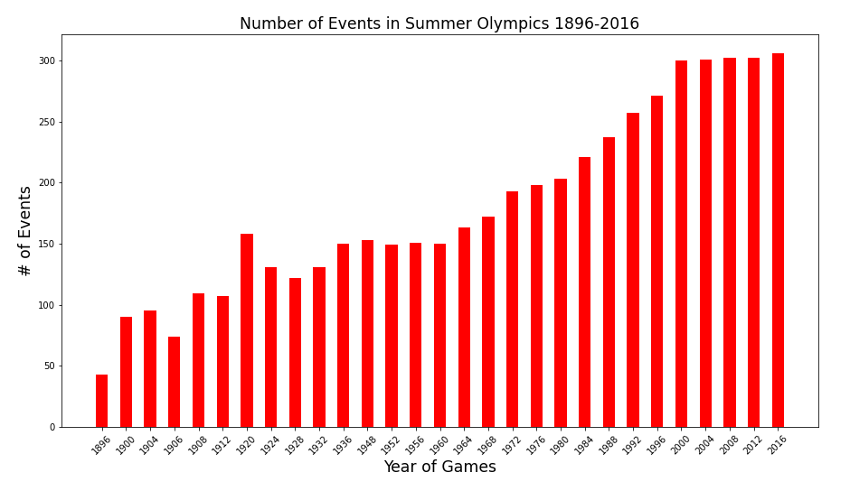
Number of Events by Year

Slide 11

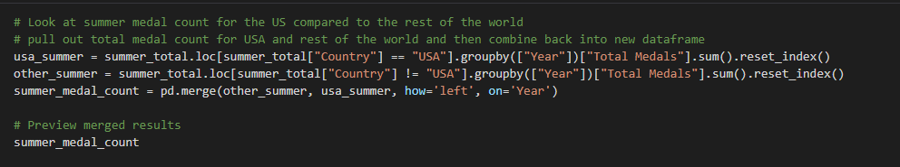

US medals vs the other regions

Slide 12
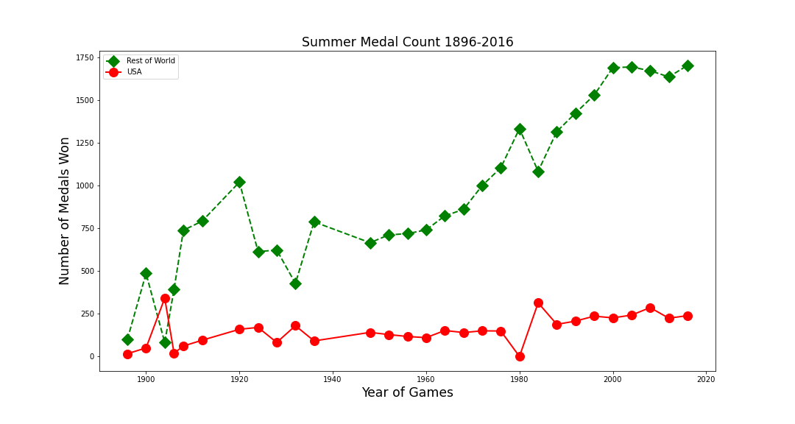
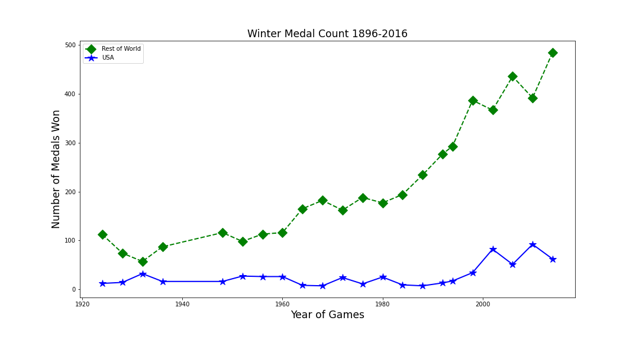
US medals vs the other regions
Notes:
Early 1900s big jump of US medals vs other regions

Slide 13
Conclusion

